Slide 1
Chapter10
Term-Structure Modela
報告者:施嘉紋
指導教授:戴天時

Slide 2
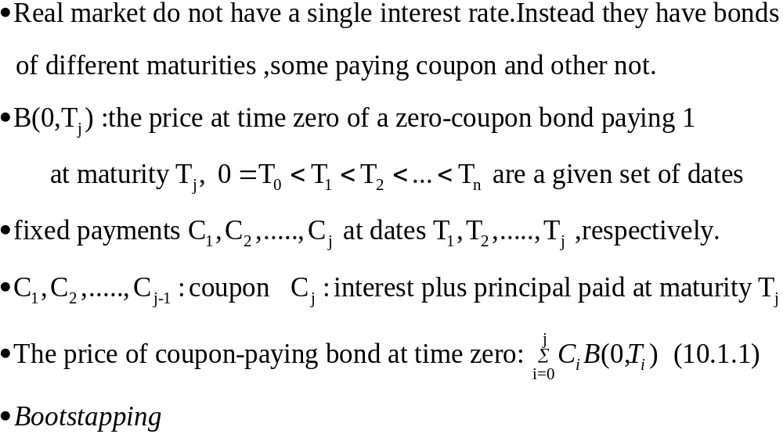
10.1 Introduction

Slide 3
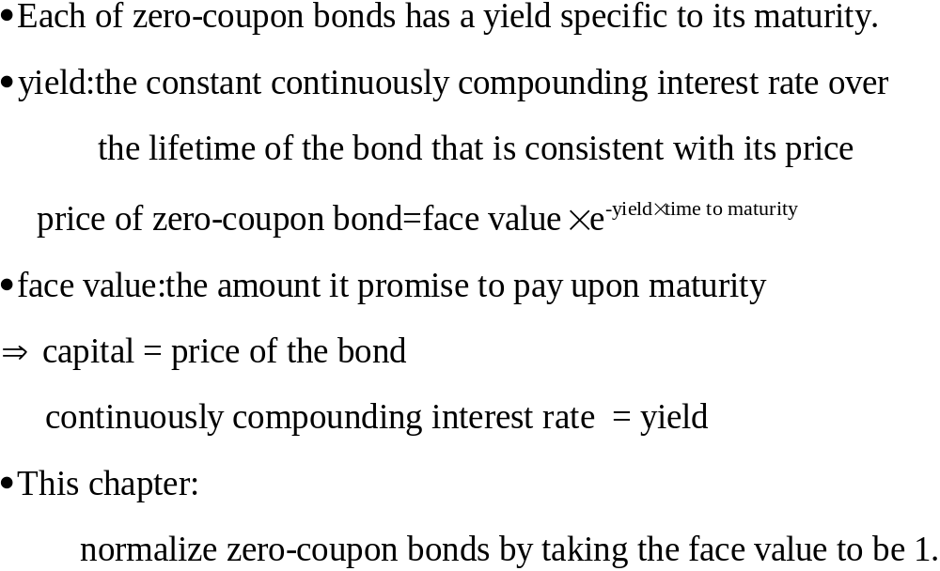

Slide 4
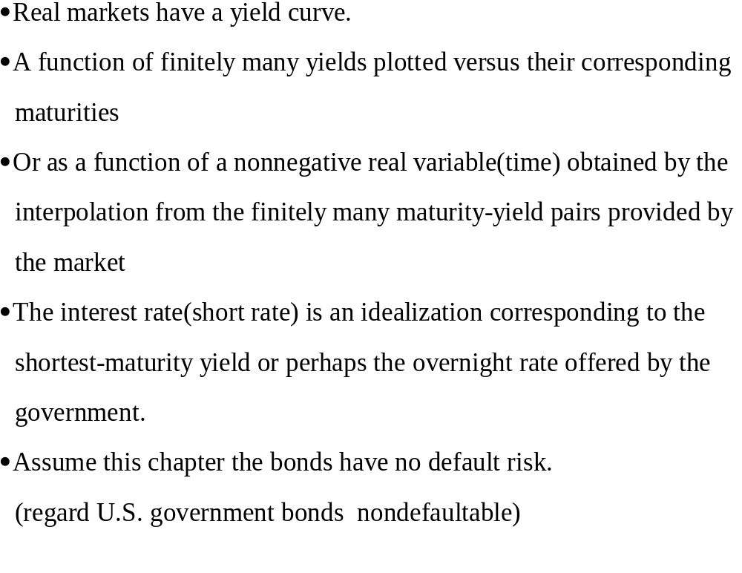

Slide 5
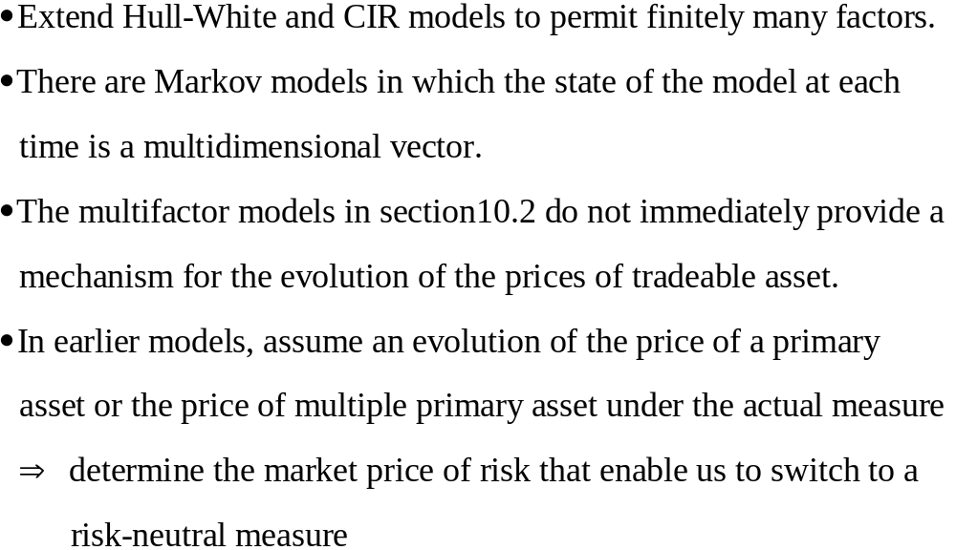

Slide 6
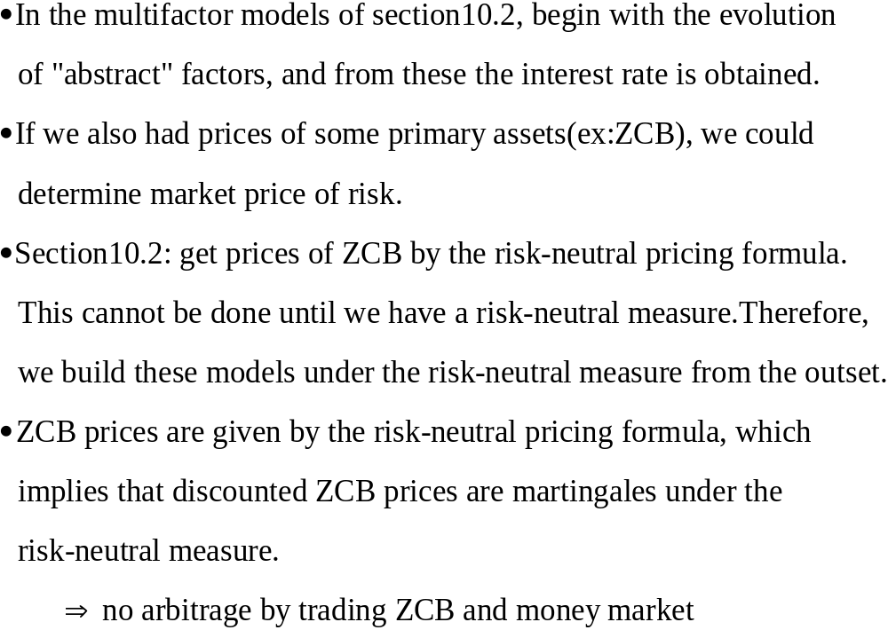

Slide 7
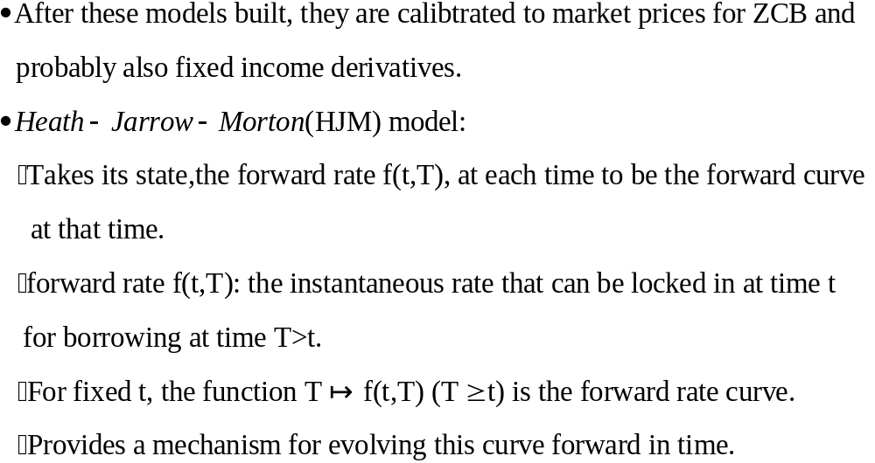

Slide 8
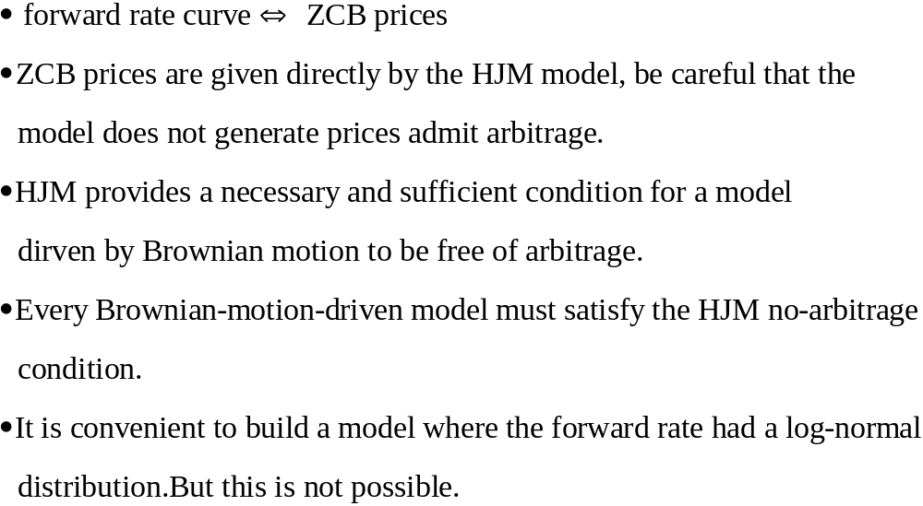

Slide 9
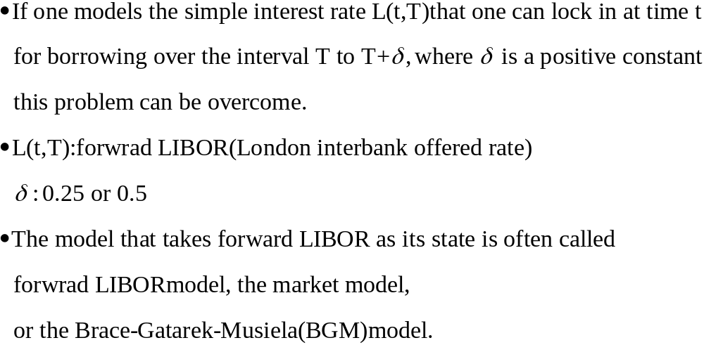

Slide 10
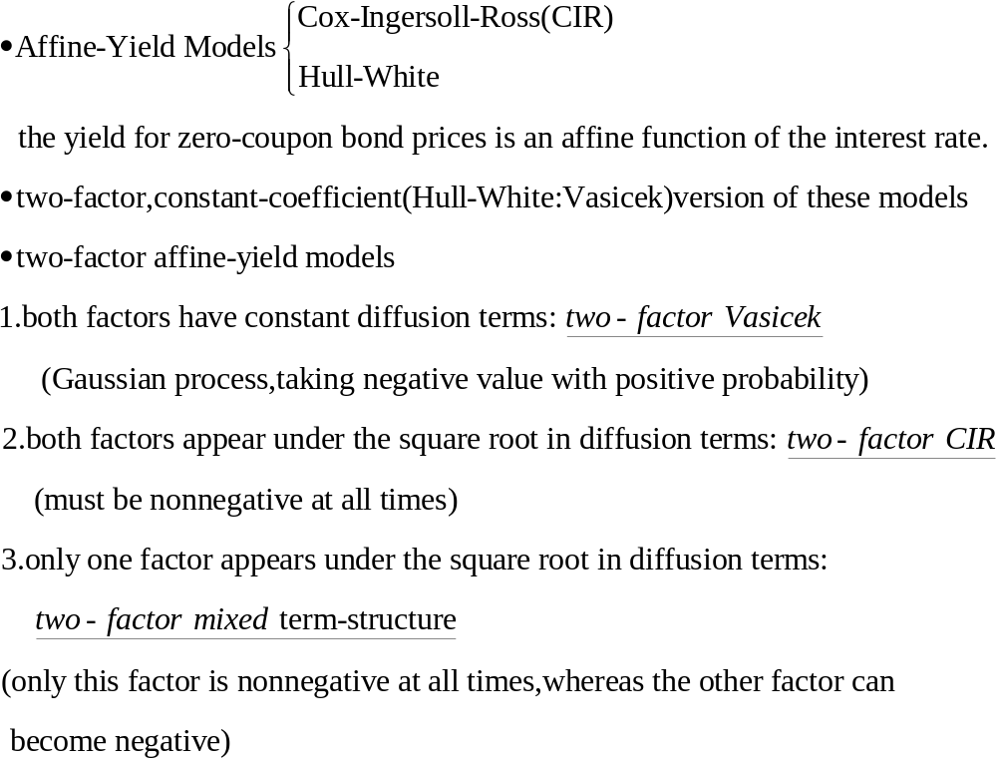
10.2 Affine-Yield Models

Slide 11
For each of these types of models, there is a canonical model(a simplest way of writing the model)
Two-factor model can be obtained from one of the three canonical models by changing variables.
It is desirable when calibrating a model to first change the variables to put the model into a form having the minimum number of parameters ; otherwise, the calibration can be confounded by the fact that multiple sets of parameters yield the same result.

Slide 12
10.2.1 Two-Factor Vasicek Model

Slide 13
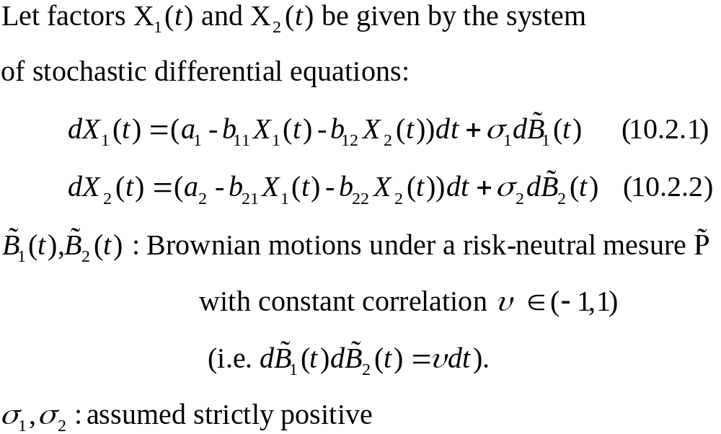
10.2.1 Two-Factor Vasicek Model

Slide 14
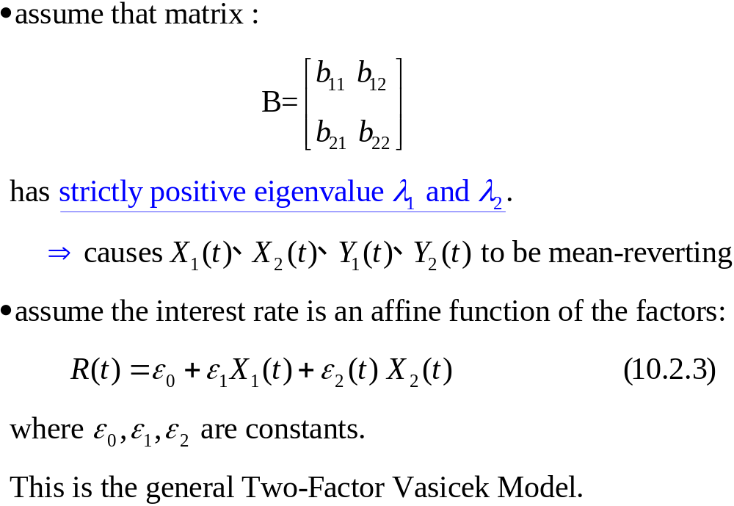

Slide 15
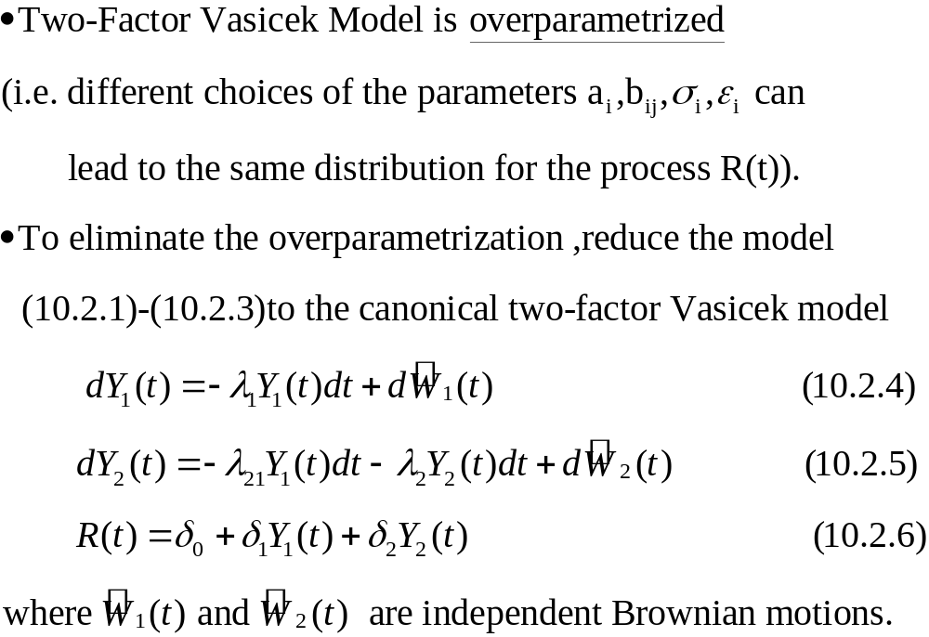
Canonical Form

Slide 16
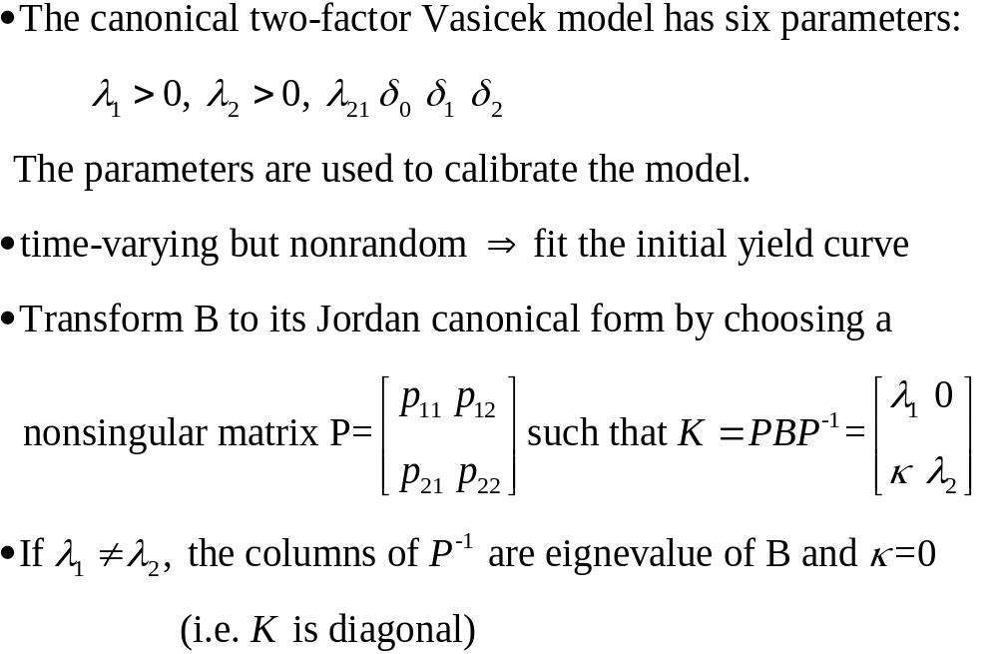

Canonical Form

Slide 17
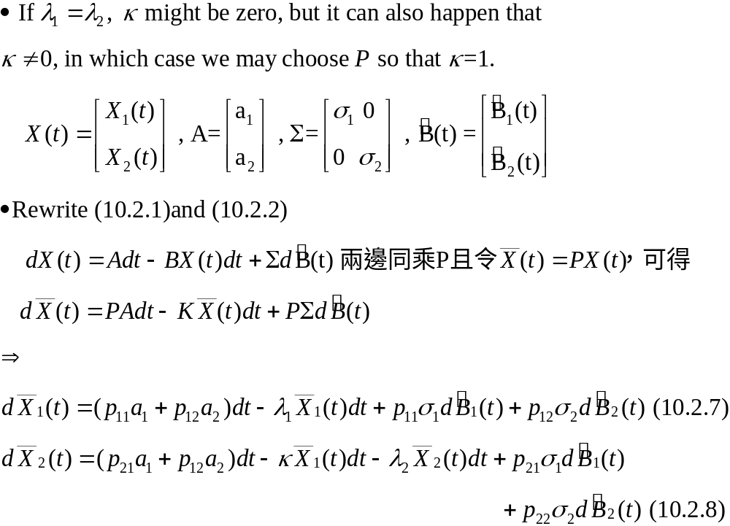

Slide 18
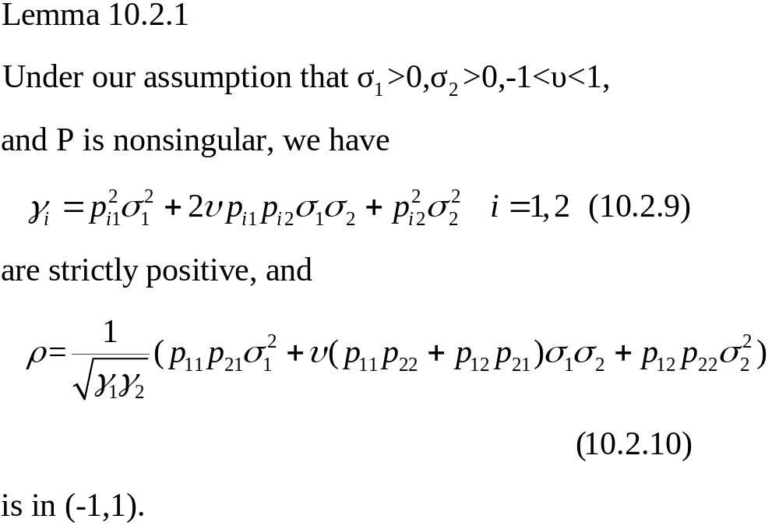

Slide 19
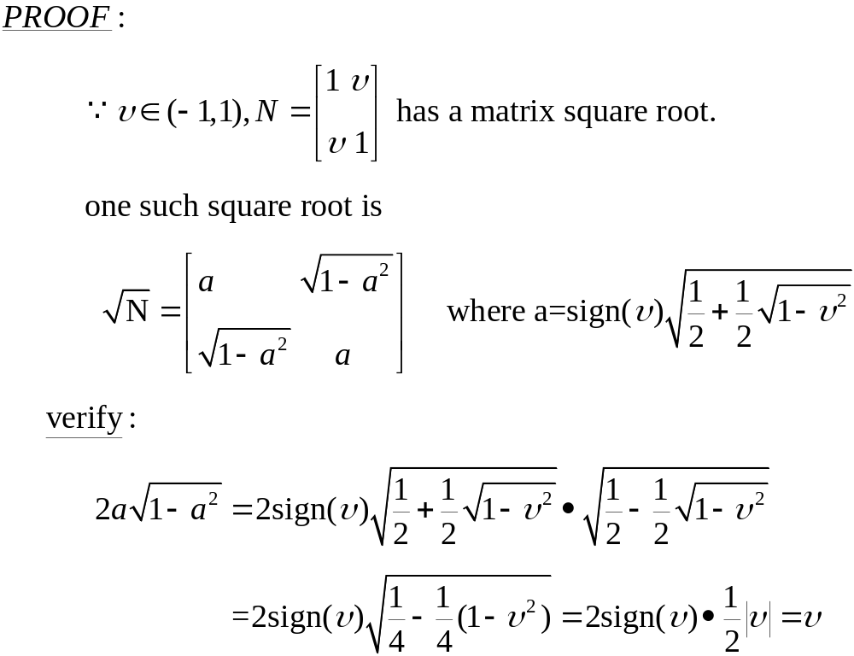

Slide 20
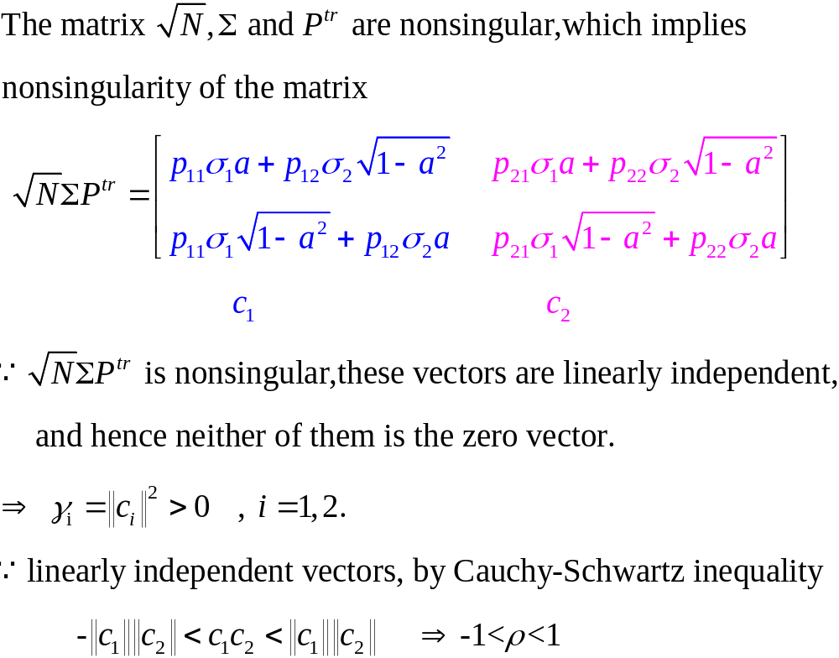

Slide 21
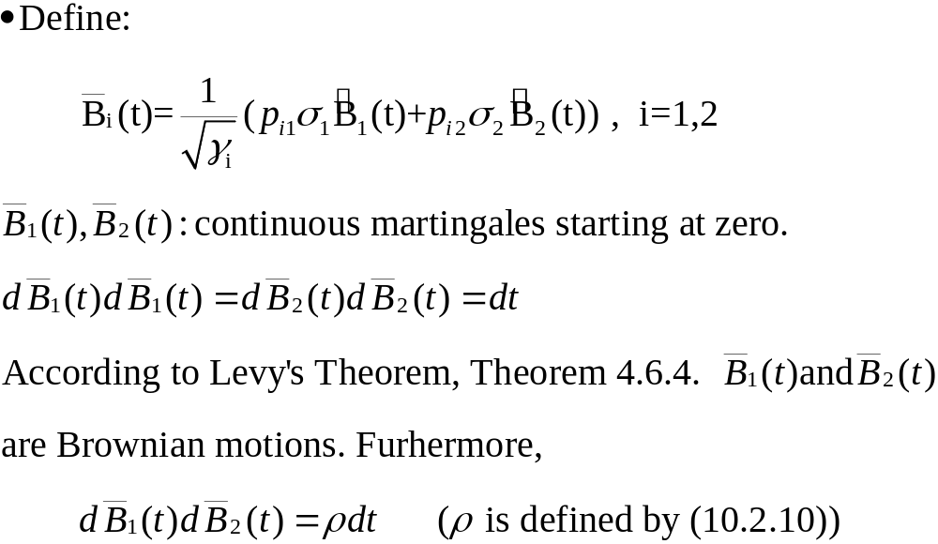

Slide 22
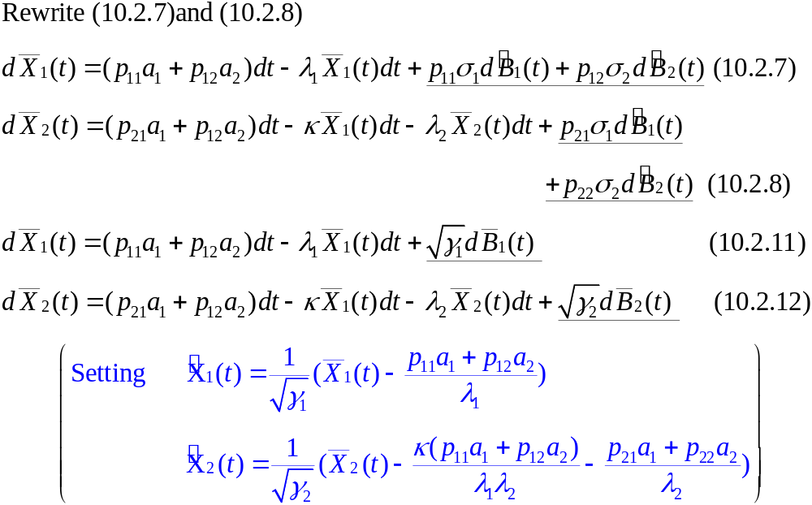

Slide 23
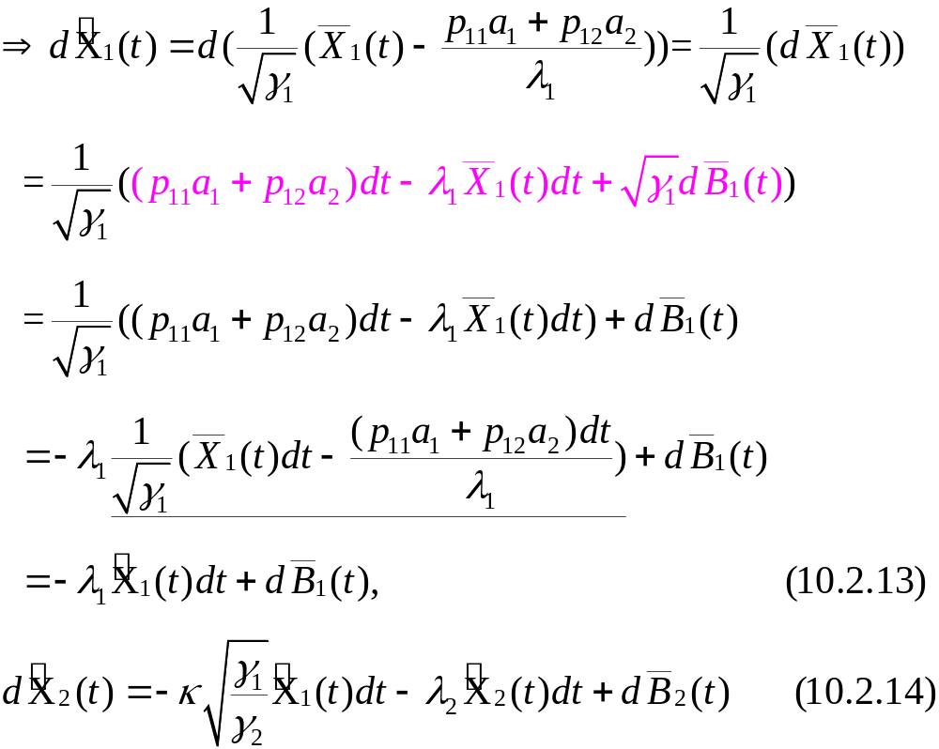

Slide 24
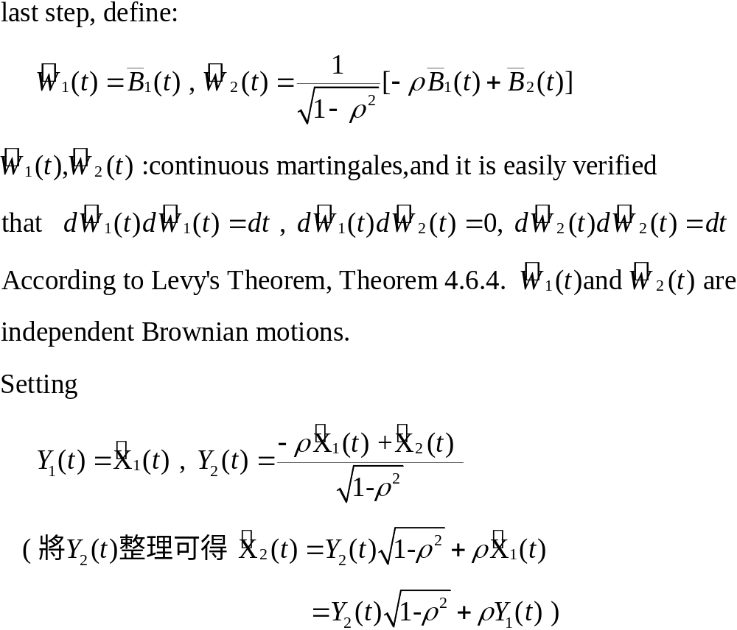

Slide 25
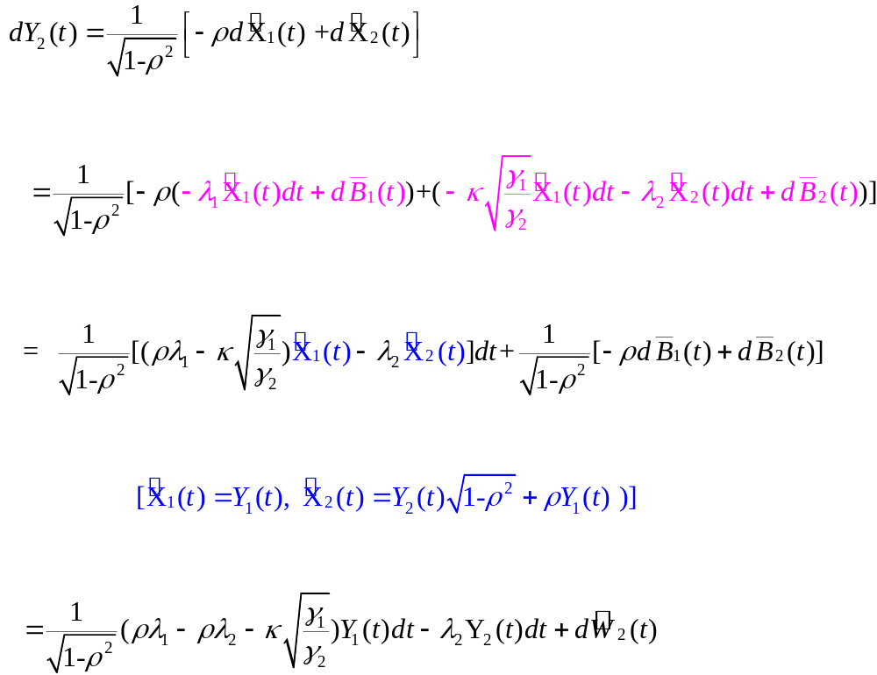

Slide 26
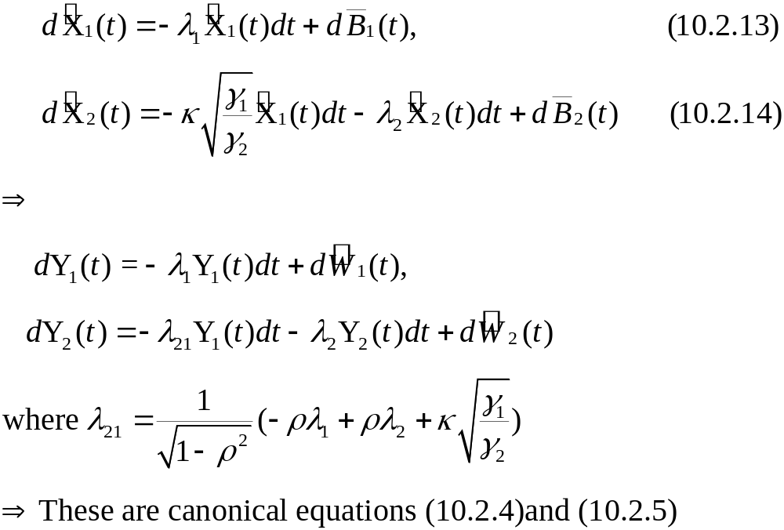

Slide 27
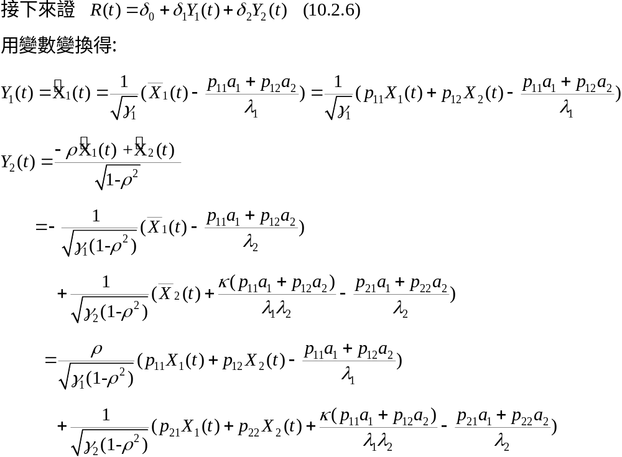

Slide 28
